Slide 1
Govt digvijay autonomous p.g .college rajnandgaon Seminar Presentation on Male Gametophyte SUBMITTED TO DEPARTMENT OF BOTANY
Guided By Presented By
SHASHI KAMAL
DEPARTMENT OF BOTANY M.Sc SECOND SEMESTER

Slide 2
Male Gametophyte Content :-
Introduction
History
Anther
Structure of anther
Tapetum
Structure of Tapetum
Function of Tapetum
Development of Anther
Successive type & Simultaneous Type
Structure of Pollen Grain
Structure of Microspore
Dehiscence of Anther
Structure of Dehiscence of Anther
Development of Male Gametophyte
Reference

Slide 3
Introduction :-
When we study about the structure of the flower . Than we know that stamen and carpel are important part of the flower .
Through this part reproduction with process take place .
Stamen is more up part two part anther and filament .
Filament support anther to attached with flower .
Formation of male gametes take place by the process of anther male gameto-genesis .

Slide 4
History :-
First time scientist Gerew considers . Stamen as the male reproduction organ given important to pollengrain .

Slide 5
Anther :-
Anther is male reproductive organ are the flower , apical fertile part of the stamen .
It consist two or more than two microsporangia which is known as pollensacs .
In contain pollengrain .
Normally anther is tetrasporangiate , but some plant is bisporangiate anther .
The wall of mature anther is known up as four layer :-
Epidermis
Endothecium
Middle layer
Tapetum

Slide 6
Structure of Anther :-
Fig-A. Typical stamen,B,Three- dimensitonal cut section of an anther C.T.S of Young Anther .

Slide 7
Tapetum :-
Tapetum is the innermost layer of anther walls, and it completely surrounds the sporogenous tissue.
This is the nutrient level.
For example :- Apple & Animone.
Tapetum is devided into 2 parts depending on the nature and functionality.
1. Plasmodial Tapetum Example – Tradescantia, Typha.
2. Glandular Tapetum Example – Higher monocots & many dicots.

Slide 8
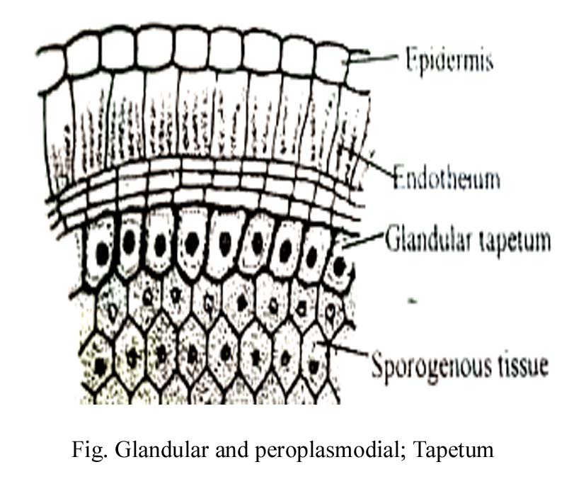
Structure of Tepetum :-

Slide 9
Function of Tepetum :-

Slide 10
Development of Anther :-

Slide 11
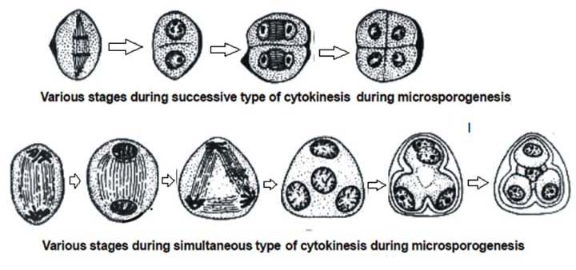
Successive type & Sumultaneous Type :-

Slide 12
Structure of Pollen Grain :-
Pollengrain considers on the first cell of the male gametophyte generation .
Study it pollengrain process of known as palynology .
The cradit of the structural study of the pollengrain is given to kolreater , erdhman is known as the father of the palynology .
The shape and size of the pollengrain are different types of spesics . But normally it is in ovad shaped .
The wall is the pollengrain of divid into two layers in which outer wall ,is known as exine , and inner wall is known as intine .
Which is rare up pectose and cellulose .

Slide 13
Structure of Microspore :-

Slide 14
Dehiscence of Anther :-
Firstly middle layer and tapetum distryed .
Due to which in anther wall only epidermis and endothecium remain .
Normally it is because of development of dehiscence longitudinal slits .
In some plants it is allso because of the development of dehiscence terminal slits or pores .
Loss of water take place during the maturity of endothecium and the outer wall of the cell get compact .
As a result there is stress in stomium , in this way by dehiscence pollengrain become free .

Slide 15
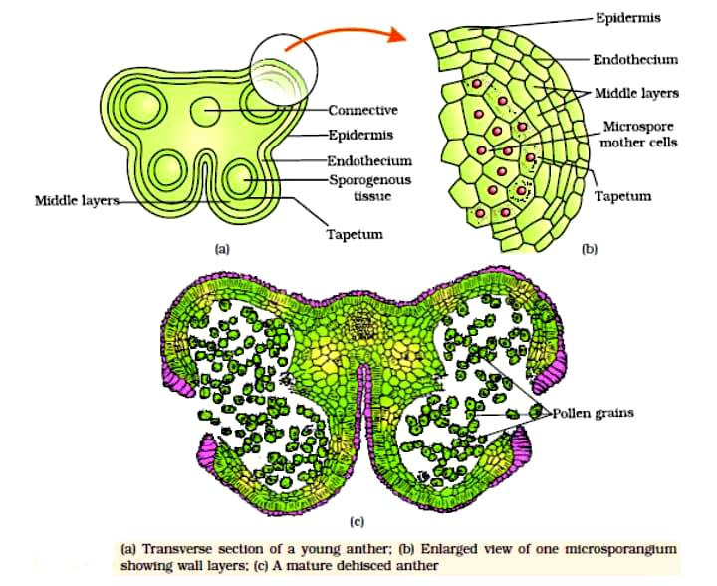
Structure of Dehiscence of Anther :-

Slide 16
Development of Male Gemetophyte :-

Slide 17
Reference :-
S.S. BHOJWANI, THE EMBRYOLOGY OF ANGIOSPERM ,S.P.BHATNAGAR,
THE EMBRYOLOGY OF ANGIOSPERM,
Dr. B.P. PANDEY – TAXONOMY, ANATOMY, EMBRYOLOGY AND ECONOMIC BOTANY.
(Adition “1981” Reprints “1985”)

